Slide 1


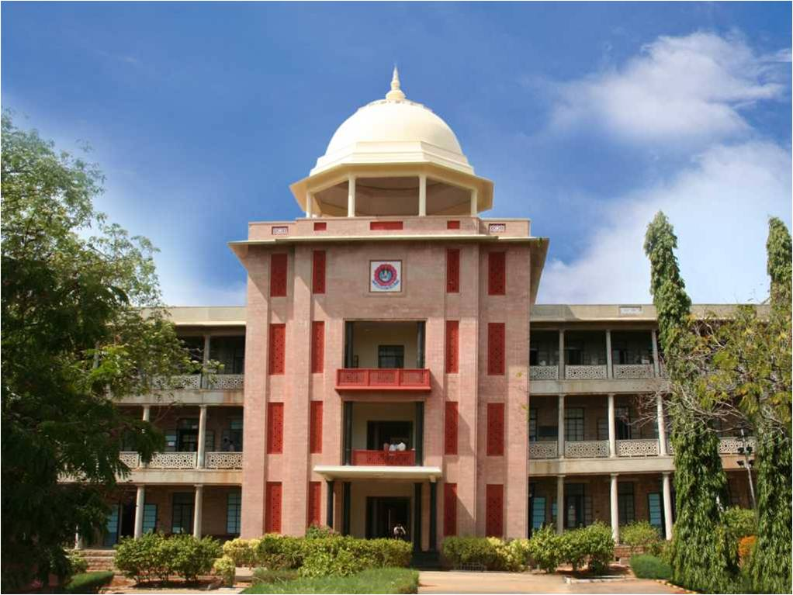
Shortest Wiring Plan
THIAGARAJAR COLLEGE OF ENGINEERING, MADURAI-15
(A Govt. Aided Autonomous Institution affiliated to Anna University)
- where quality and ethics matter
Rishi Varman RT (18C080)
Adithya Akilesh Kumar KA (18C004)
Shailesh Babu SV (18C094)
Yudhish Kumar A (18C125)
Shree Shylesh N (18C096)
Ritik Singh Jamwal (18C081)
*
<Department Name>
1

Slide 2
Introduction
Due to the growing architecture and engineering, buildings now have complex interiors. In such buildings the electrical connections to the rooms should be done in an efficient way so that the any problem in the circuits can be easily identified. So, we developed an application which can suggest shortest routes to lay the wiring from the power source to the interior of a building.
*
<Department Name>
2

Slide 3
Literature Review
S.No | Title | Author Name | Name of Journal | Contribution
1 | The Improved Dijkstra's Shortest Path Algorithm and Its Application | WangShu-Xi | School of Information Technology The University of International Business and Economics | Efficient implementations of Dijkstra's shortest path algorithm are investigated. A new data structure, called the radix heap, is proposed for use in this algorithm
2 | The Design and Analysis of Computer Algorithms | AHO, A. V., HOPCROFT, J. E., AND ULLMAN, J. D. | Journal of the ACM | A two-level form of radix heap gives a bound of O(m + n log C/log log C). A combination of a radix heap and a previously known data structure called a Fibonacci heap gives a bound of O(m + na @@@@log C). The best previously known bounds are O(m + n log n) using Fibonacci heaps alone and O(m log log C) using the priority queue structure
3 | Research Articles in Simplified HTML: a Web-first format for HTML-based scholarly articles | Silvio Peroni Francesco Osborne Angelo Di Iorio Andrea Giovanni Nuzzolese | Peroni et al. (2017), PeerJ Comput. Science. | e. This paper introduces the Research Articles in Simplified HTML (or RASH), which is a Web-first format for writing HTML-based scholarly papers; it is accompanied by the RASH Framework, a set of tools for interacting with RASH-based articles. The paper also presents an evaluation that involved authors and reviewers of RASH articles submitted to the SAVE-SD 2015 and SAVE-SD 2016 workshops

Slide 4
Problem Statement
During the designing of the model of buildings like houses, apartments or schools the electrical wires should be laid and connected from the power source to each room in an optimum manner such that they reach the destination from the main in the shortest route as possible. This activity becomes tedious in case of a complex building.

Slide 5
Objective
To take a real model of a house or building and estimate the optimum wiring distance.
The basic objective is to find the shortest path between two rooms in a building. To create a web application which takes two inputs a source (power main or any room) and destination (any room) and outputs the shortest path to reach the destination from the source.

Slide 6
Methodologies
The algorithm used here is Dijkstra’s algorithm.
The workflow goes by:
Get the source
Get the destination
The shortest route to lay the wire is displayed

Slide 7
Algorithm
function Dijkstra (Graph, source):
create vertex set Q
for each vertex v in Graph:
dist[v] ← INFINITY
prev[v] ← UNDEFINED
add v to Q
dist[source] ← 0
while Q is not empty:
u ← vertex in Q with min dist[u]
remove u from Q
for each neighbor v of u: // only v that are still in Q
alt ← dist[u] + length(u, v)
if alt < dist[v]:
dist[v] ← alt
prev[v] ← u
return dist[], prev[]

Slide 8
Contribution
Adithya Akilesh Kumar and Shree Shylesh – Creating Gif and linking it with the webpage
Rishi Varman and Yudhish Kumar– Coding the javascript code for the algorithm to be implemented
Shailesh Babu and Rithik Sing Jamal – Designing the webpage

Slide 9
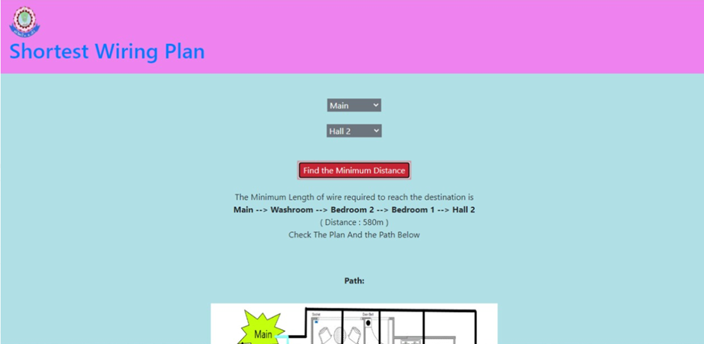
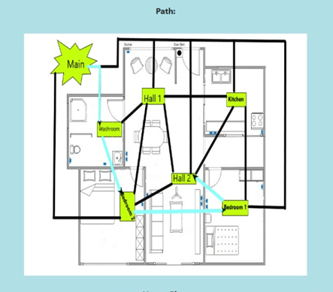
Results
Thus we built a web application which provides the shortest path between two rooms in a building. It will help the people who design the building models to plan the wiring path easily and efficiently.

Slide 10
Conclusion and Future work
We have considered a simple model of a house for the application. In future we will improve our application so that it is useful for much bigger buildings such as apartments, schools, colleges etc.

Slide 11
References
https://devdocs.io/html/
https://developer.mozilla.org/en-US/docs/Web/JavaScript
https://www.w3schools.com/cssref/
https://www.geeksforgeeks.org/dijkstras-shortest-path-algorithm-greedy-algo-7/
https://www.programiz.com/dsa/dijkstra-algorithm
https://github.com/mburst/dijkstras-algorithm
https://github.com/perliedman/geojson-path-finder
https://github.com/andrew128/ShortestPathFinder
https://github.com/wnmunirah/path

